Slide 1
Pulmonary Circulation
Professor Narsingh Verma

Slide 2
Differences from Systemic Circulation
Low peripheral Resistance
Low pressure
Systolic20-25 mm Hg, Diastolic 6 -12 mm Hg & Mean 15mm Hg
Pulmonary Arterioles Thin walled, large lumen
Pulmonary Capillaries shorter and wider and blood flow is pulsatile
Gas exchange is across Alveolocapillary membrane
No interstitial tissue fluid
Pressure in large pulmonary vein is about 8 mm Hg
Abundant Lymphatics

Slide 3
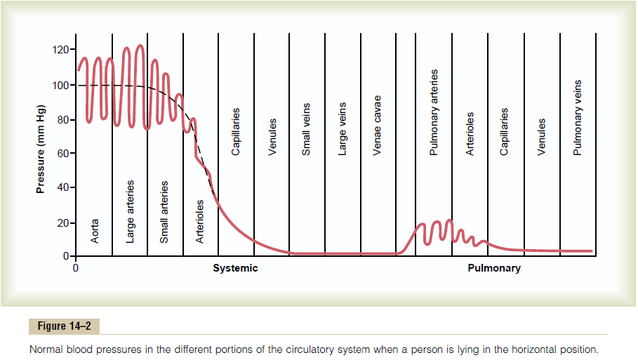
Comparison of pressures in systemic and pulmonary circulations.

Slide 4
Different blood flow
Blood flow to apex and base of Lungs are different lower at apical region and at base higher than middle segment of lung
No interstitial fluid in lungs Alveoli remain dry to facilitate diffusion of Gases
Pulmonary capillary hydrostatic pressure is 10 mmHg and Colloid osmotic pressure of 25 mmHg results in a net suction force of 15mmHg which tends to draw fluid from alveolar interstitial space in to capillaries

Slide 5
Supra physiological states
If Pulmonary capillary Hydrostatic Pressure Rises above 25 mmHg Fluid can escape in to Interstitial space
This can Happen during Exercise at High altitude
Some fluid is trapped between collagen fibers delaying and preventing pulmonary edema
J receptors are also stimulated leading to reflex tachypnea and reduction of skeletal muscle tone
AS Piantal postulated that stimulation of J receptors induces Dyspnea which along with reduced muscle tone would discourage exercise preventing pulmonary congestion

Slide 6
Effect of Increased Cardiac Output on Pulmonary Blood Flow and Pulmonary Arterial Pressure During Heavy Exercise
During heavy exercise, blood flow through the lungs increases fourfold to sevenfold.
This extra flow is accommodated in the lungs in three ways:
(1) by increasing the number of open capillaries,
(2) by distending all the capillaries
(3) by increasing the pulmonary arterial pressure.

Slide 7
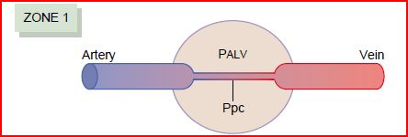
Zones of Pulmonary Blood Flow
Zone 1 blood flow
No blood flow during all portions of the cardiac cycle
Zone 1 Blood Flow Occurs Only Under Abnormal Conditions.
occurs when either the pulmonary systolic arterial pressure is too low or the alveolar pressure is too high to allow flow
Too high alveolar pressure e.g. Breathing against a positive air pressure
After severe blood loss.

Slide 8
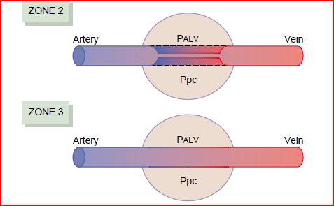
Zones of Pulmonary Blood Flow
Zone 2 (intermittent fblood low) in the apices.
In normal lungs, this zone is about 10 centimeters above the midlevel of the heart and extends from there to the top of the lungs
Blood flows during systole but not during diastole.
Zone 3 (continuous blood flow throughout the cardiac cycle) in all the lower areas.
from about 10 centimeters above the level of the heart all the way to the bottom of the lungs,

Slide 9
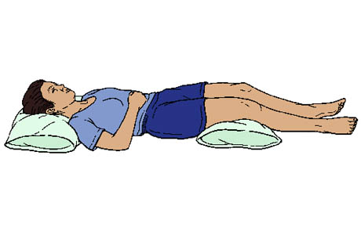
In lying posture, all lung has got zone 3 .

Slide 10
Physiological Shunt = Bronchial Circulation Arterio-luminal veins and Thebesian veins
Major function is respiratory gas exchange
Removal of Emboli
Presence of small emboli in pulmonary capillaries may excite J receptors ----reflex increase in pulmonary arterial pressure ----Raised Pulmonary Capillary pressure ----Filtration of emboli out of the capillaries into lung parenchyma---cleared by macrophages
Large embolus has blocked medium sized artery—Bronchial artery circulation keeps nourishment ------Embolus may break into smaller fragments ---cleared

Slide 11
Immunological Functions
well developed local immunological mechanisms involving vessels and lymphatics
Reservoir Function holds about 18% of total blood Volume, about half of it can be released when required

Slide 12
Regulation of Pulmonary Circulation
Blood vessels have rich innervation of Sympathetic vasoconstrictive nerves but no resting tone
Take part in circulatory reflexes
Most of the significant alteration in pulmonary blood flow occurs in response to local change in partial pressure of O2
Low PO2 produces vasoconstriction = opposite to systemic circulation
Blood flow as per ventilation
To distribute blood flow to most Oxygenated Alveoli

Slide 13
Why Tuberculosis is more common in apical regions of the lungs
Poor blood flow in apical region
Immune system gets weak
Comparatively more oxygen is available

Slide 14
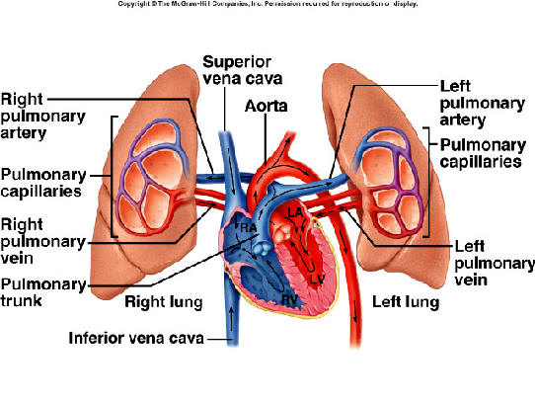
Pulmonary Edema
CAUSES
Left-sided heart failure
mitral valve disease
Damage to the pulmonary blood capillary membranes
Infections (pneumonia)
Breathing noxious substances such as chlorine gas or sulfur dioxide gas

Slide 15
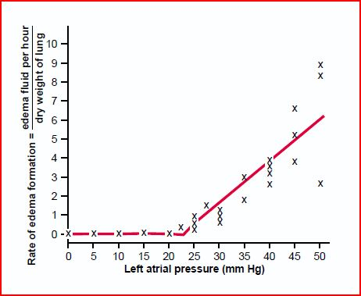
Pulmonary Edema Safety Factor
pulmonary capillary pressure must rise from the normal level of 7 mm Hg to more than 28 mm Hg
Safety factor against pulmonary edema of 21 mm Hg.

Slide 16
Rapidity of Death in Acute Pulmonary Edema
A medical emergency
Cause: Acute left-sided heart failure
Pulmonary capillary pressure may rise more than 50 mmHg
Death frequently ensues in less than 30 minutes in severe cases

Slide 17
Cerebral Circulation
Vital organ
Normally utilizes only glucose as fuel
Exclusively Aerobic Metabolism
Fairly Constant does not participate in baro and chemo reflexes
Autoregulated and very few controls
Property of blood vessels
High BP----stretching of cerebral arterial wall activates smooth muscle cells ----Vasoconstriction and CBF remains Normal similarly fall in BP------Vasodilation

Slide 18
Cerebral blood flow
Region of brain performing task receives more blood supply
Only a small part of brain remains active at atime
CBF is about 770ml/mts 15% of cardiac output
Grey matter is better supplied than white matter
2 internal carotid artery
They give rise anterior and middle cerebral arteries
2 vertebral arteries they unite to farm basilar artery ----2 posterior cerebral artery connected to an anterior communicating and 2 posterior communicating artery

Slide 19
Cercle of Willis
3 pairs of cerebral artery and 3 communicating artery farm the circle of Willis at the base of the brain
Venous drainage is partly in to large subdural sinuses and partly in to paravertebral veins and other cranial veins
Cerebral blood vessels are supplied by sympathetic vasoconstrictor nerves from cervical ganglia
They do have parasympathetic vasodilatory fibers and sensory nerve supply
Cerebral blood vessels are highly sensitive to pain

Slide 20
Special Features
Blood Brain Barrier Cerebral capillaries do not come in contact with neurons
Glial cells , mainly astrocytes are interposed between neurons and blood vessels
Cerebral capillaries have a thick basement membrane and hardly any fenestration, the poorly permeable capillaries and astrocytes provide physical basis of BBB
Transport of substance from blood to brain is slow and limited
Permeable for gases
Protects from toxic substances

Slide 21
Regulation
CSF pressure is directly related to JVP
If there is rise of intracranial pressure due to a brain tumor veins are first to be affected == Papilledema==Edema of Optic disc
Increased PCO2 in plasma increases cerebral blood flow tremendously
Increased PO2 produces cerebral vasoconstriction
Anesthetic agents decrease cerebral blood flow
Supplied by sympathetic, parasympathetic and sensory nerves
Blood flow is regulated mainly by PCO2

Slide 22
Local control
Regional adjustment in cerebral blood flow
Neuronal metabolic activity leads to localized rise of PCO2
Additionally potassium ions, NO and adenosine are vasodilatory
Astrocytes and Glutamate

Slide 23
Regulation of Cerebral Blood flow in increased Intracranial pressure
Rise in Intracranial Pressure from the normal level of 8cm H2O to 45cm H2O causes linear rise in arterial blood pressure although cerebral blood flow remains constant by autoregulation
After 45cm H2O intracranial pressure cerebral blood flow decreases progressively == cerebral ischemia == stimulates the vasomotor center == raises blood pressure === Cushing Reflex

Slide 24
Blood Flow through liver
Splanchnic circulation
At rest 30 % of the cardiac output
Liver receives blood from two sources
Hepatic artery oxygenated blood
Portal vein deoxygenated but rich in nutrients from Intestine, pancreas and spleen
These two sources mix in distal portions of hepatic sinusoids ==hepatic vein ==IVC

Slide 25
Control of Hepato Portal Circulation
Both hepatic artery and portal vein are richly supplied by sympathetic vasoconstrictor noradrenergic fibers ===tone of precapillary sphincter
Metabolic activity of liver ==accumulation of metabolites CO2 and H+ ion ===decreases precapillary sphincter tone ==increased hepatic arterial flow ==portal venous flow decreases

Slide 26
Intestinal Circulation
Superior and inferior mesenteric arteries
Extensive anastomosis
Mucosa receives more blood than serosa
Supplied by sympathetic vasoconstrictor nerves
Metabolites dilates
GI hormones
Increase intestinal blood flow== increased portal vein flow

Slide 27
Splenic circulation
Splenic artery supplied by vasoconstrictive sympathetic nerve fibers
Veins do have sympathetic supply
Increased sympathetic stimulation to veins
== blood is diverted from spleen to splanchnic circulation
Act as reservoir of blood

Slide 28
Renal circulation
Renal artery
High renal blood flow
Cortex receives higher rate of blood flow
Afferent Arteriole have high hydrostatic pressure of 60 mm Hg
Blood flow through vasa recta is slow == leads to accumulation of Na and other ions == Hyperosmolarity of Medula === Basis for CCM
Renal capillaries have large pore size ==Fenestrated
Afferent arteriole and DCT form JGA
Autoregulation of Renal blood flow

Slide 29
Skeletal Muscle Circulation
Marked 25% variation in blood flow
Richly innervated by sympathetic nerve fibres of two types
Sympathetic noradrenergic fibres with vasoconstrictor effect
Sympathetic cholinergic fibres with vasodilatory effect
These fibres do not participate in generalized vasomotor reflex responses because they originate in cerebral cortex and desend with out relaying at vasomotor centre
Precapillary sphincters are highly sensitive to hypoxia, Increased PCO2 & H+ ion conc.

Slide 30
Exercise
Muscle blood flow increases even before exercise begins
Thought– Neural reflexes from cortex stimulate sympathetic cholinergic fibers supplying muscle blood vessels ==vasodilation but they supply only arteriovenous channels not the precapillary sphincters==warm up the muscles
After exercise begins ==exercising muscles start consuming more oxygen and producing more CO2 and meatbolites such as ADP ,Adenosine, hydrogen ions and lactic acids
Local hypxia and accumulation of metabolites ==relaxation of precapillary sphincters ==increased blood flow to capillaries

